Slide 1
Elements of the Analysis Model
Object-oriented Analysis
Procedural/Structured Analysis
Scenario-based
modeling
Flow-oriented
modeling
Use case text
Use case diagrams
Activity diagrams
Swim lane diagrams
Data structure diagrams
Data flow diagrams
Control-flow diagrams
Processing narratives
Class-based
modeling
Behavioral
modeling
Class diagrams
Analysis packages
CRC models
Collaboration diagrams
State diagrams
Sequence diagrams

Slide 2
Sequence Diagrams

Slide 3
Interaction Diagrams
A series of diagrams describing the dynamic behavior of an object-oriented system.
  A set of messages exchanged among a set of objects within a context to accomplish a purpose.
Often used to model the way a use case is realized through a sequence of messages between objects.

Slide 4
Interaction Diagrams (Cont.)
The purpose of Interaction diagrams is to:
  Model interactions between objects
  Assist in understanding how a system (a use case) actually works
  Verify that a use case description can be supported by the existing classes
  Identify responsibilities/operations and assign them to classes

Slide 5
Interaction Diagrams (Cont.)
UML
  Collaboration Diagrams
    Emphasizes structural relations between objects
  Sequence Diagram

Slide 6
Importance of Sequence Diagrams
Depict object interactions in a given scenario identified for a given Use Case
Specify the messages passed between objects using horizontal arrows including messages to/from external actors
Time increases from Top to bottom

Slide 7
Sequence Diagrams
Sequence diagrams illustrate how objects interact with each other.
They focus on message sequences, that is, how messages are sent and received between a number of objects.
The Branches, Conditions, and Loops may be included.
Emphasizes time ordering of messages.
Can model simple sequential flow, branching, iteration, recursion and concurrency.

Slide 8
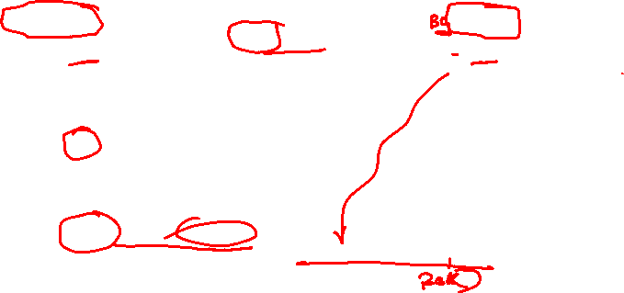
A Sequence Diagram
member:
LibraryMember
book:Book
:Book
Copy
borrow(book)
ok = mayBorrow()
[ok] borrow(member)
setTaken(member)

Slide 9

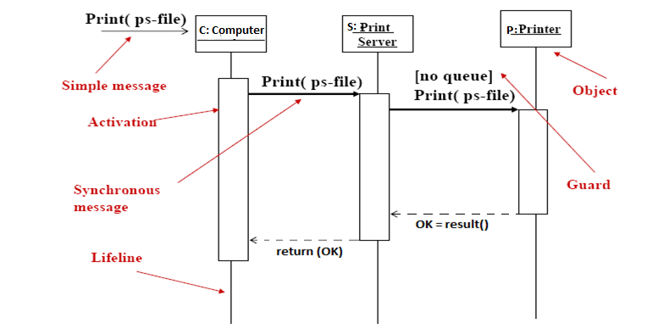
Sequence Diagram - Syntax
.

Slide 10
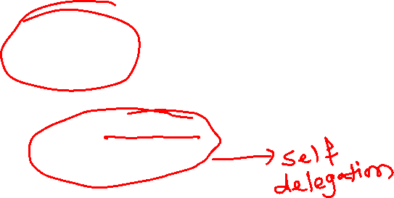
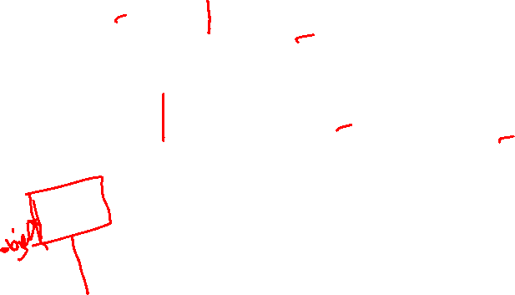
A Sequence Diagram
X-Axis (objects)
member:
LibraryMember
book:Book
:Book
Copy
borrow(book)
Object
Life Line
Y-Axis (time)
ok = mayBorrow()
message
Activation box
[ok] borrow(member)
setTaken(member)
condition

Slide 11

Object
Object naming:
  syntax: [instanceName][:className]
  Name classes consistently with your class diagram (same classes).
  Include instance names when objects are referred to in messages or when several objects of the same type exist in the diagram.
The Life-Line represents the object’s life during the interaction
myBirthday
:Date

Slide 12
Messages
An interaction between two objects is performed as a message sent from one object to another (simple operation call, Signaling, RPC)
If object obj₁ sends a message to another object obj₂ some link must exist between those two objects (dependency, same objects)

Slide 13
Message types
Synchronous messages
Asynchronous messages

Slide 14
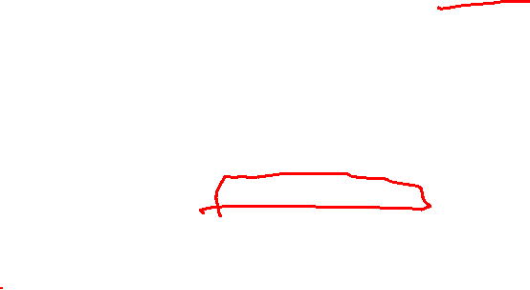
Messages (Cont.)
A message is represented by an arrow between the lifelines of two objects.
  Self calls are also allowed
  The time required by the receiver object to process the message is denoted by an activation-box.
A message is labeled at minimum with the message name.
  Arguments and control information (conditions, iteration) may be included.

Slide 15
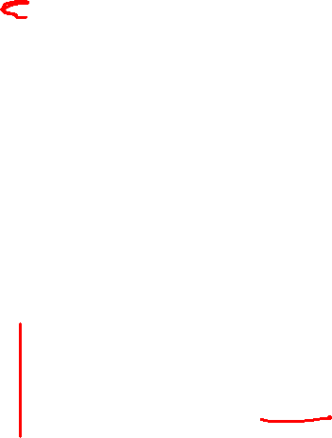
Return Values
Optionally indicated using a dashed arrow with a label indicating the return value.
  Don’t model a return value when it is obvious what is being returned, e.g. getTotal()
  Model a return value only when you need to refer to it elsewhere, e.g. as a parameter passed in another message.
  Prefer modeling return values as part of a method invocation, e.g. ok = isValid()

Slide 16

Asynchronous messages
.
Asynchronous calls, which are associated with operations, typically have only a send message, but can also have a reply message.
In contrast to a synchronous message, the source lifeline is not blocked from receiving or sending other messages.
You can also move the send and receive points individually to delay the time between the send and receive events.
You might choose to do this if a response is not time sensitive or order sensitive.

Slide 17

Synchronous Messages
Nested flow of control, typically implemented as an operation call.
  The routine that handles the message is completed before the caller resumes execution.
:A
:B
doYouUnderstand()
return (optional)
Caller Blocked
yes

Slide 18
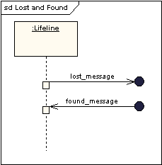
Lost and Found Messages
Lost messages are those that are either sent but do not arrive at the intended recipient, or which go to a recipient not shown on the current diagram.
Found messages are those that arrive from an unknown sender, or from a sender not shown on the current diagram. They are denoted going to or coming from an endpoint element.

Slide 19
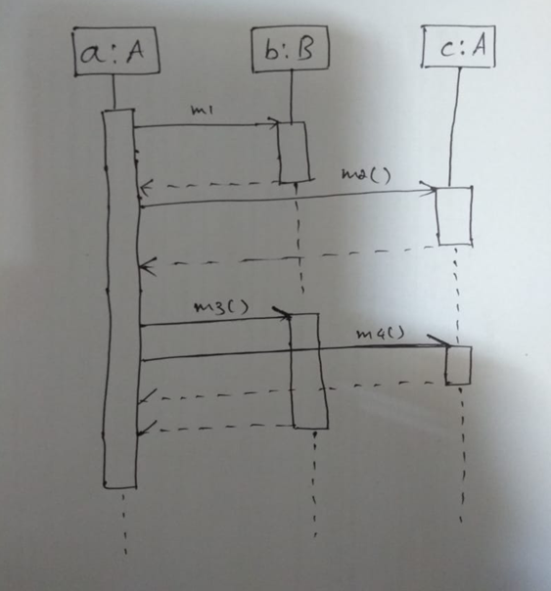
Sequence Diagrams

Slide 20
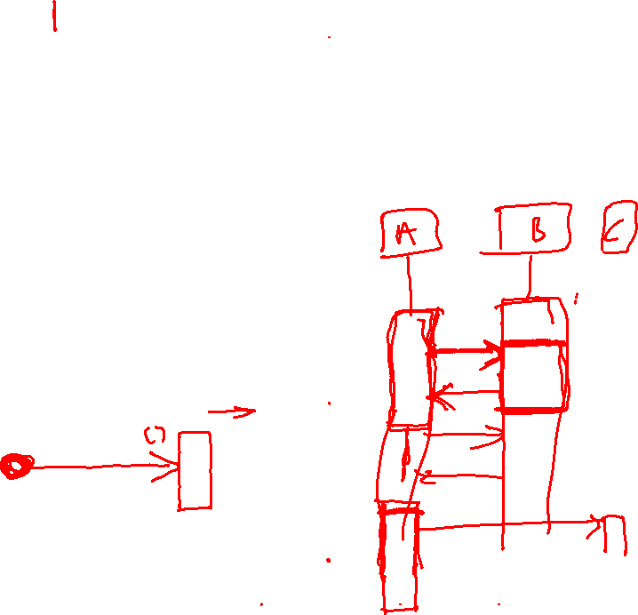
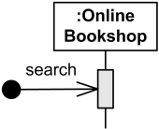
Found & Lost Message
Found Message is a message where the receiving event is known, but there is no (known) sending event
Online Bookshop gets search message of unknown origin.

Slide 21
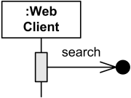
Found & Lost Message
Lost Message is a message where the sending event is known, but there is no receiving event
Web Client sent search message which was lost.

Slide 22
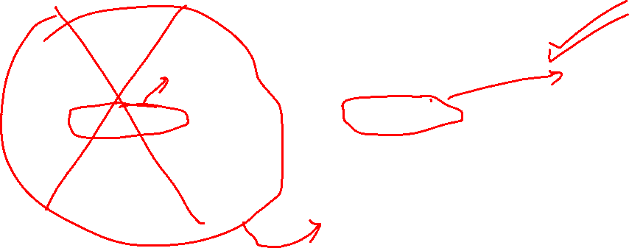
Object Creation
An object may create another object via a <<create>> message.
Preferred
:A
:B
:A
<<create>>
<<create>>
:B
Constructor

Slide 23

Object Destruction
An object may destroy another object via a <<destroy>> message.
  An object may destroy itself.
  Avoid modeling object destruction unless memory management is critical.
:A
:B
<<destroy>>

Slide 24
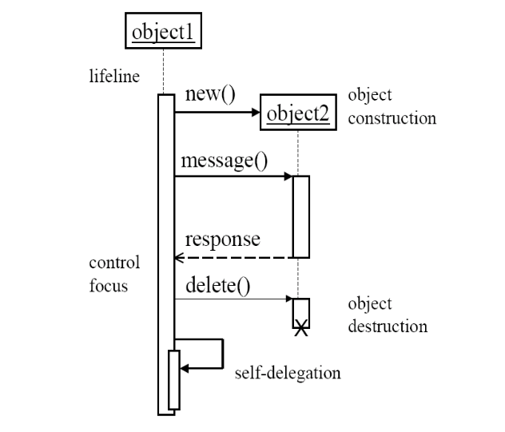
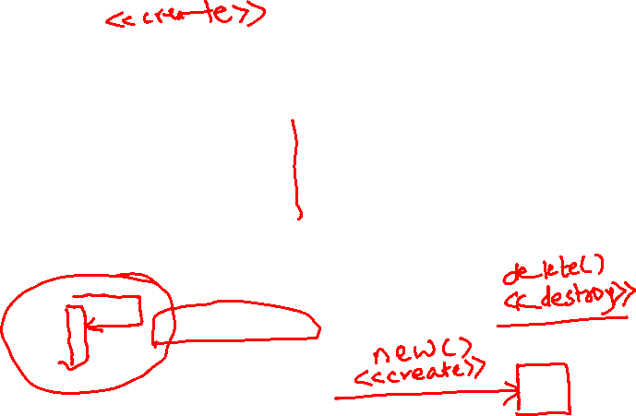
Sequence Diagram - 2

Slide 25
Control information
Condition
  syntax: ‘[‘ expression ’]’ message-label
  The message is sent only if the condition is true
  example:
Iteration
  syntax: * [ ‘[‘ expression ‘]’ ] message-label
  The message is sent many times to possibly multiple receiver objects.
[ok] borrow(member)

Slide 26
Control Information (Cont.)
Iteration examples:
:CompoundShape
:Shape
:Driver
:Bus
draw()
*draw()
*[until full] insert()
The syntax of expressions is not a standard

Slide 27
Control Information (Cont.)
The control mechanisms of sequence diagrams suffice only for modeling simple alternatives.
  Consider drawing several diagrams for modeling complex scenarios.
  Don’t use sequence diagrams for detailed modeling of algorithms (this is better done using activity diagrams, pseudo-code or state-charts).

Slide 28
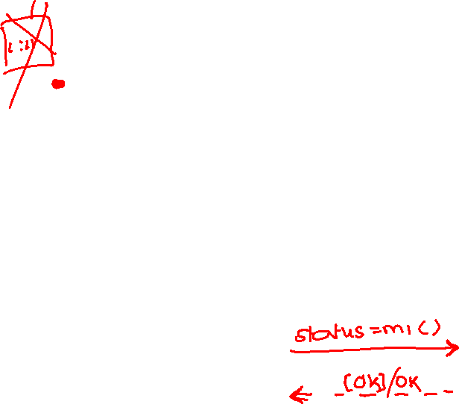
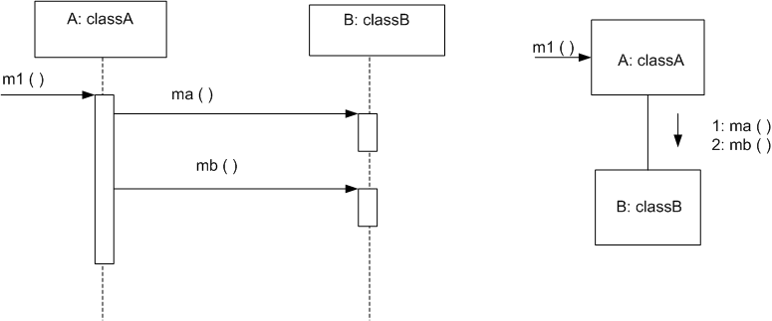
Sequence Diagram basic example
public class classA
private classB B = new ClassB();
public void m1(){
B. ma();
B.mb();
}

Slide 29
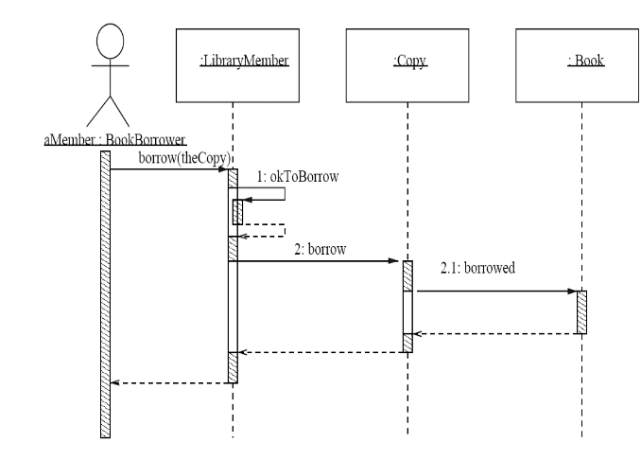
Nested activation

Slide 30
Example 1
:Violations
Dialog
:Violations
Controller
:Violations
DBProxy
Lookup Traffic Violation
Clerk
lookup
viewButton()
id=getID()
Sequence Diagrams
May be a pseudo-method
getViolation(id)
<<create>>
v:Traffic
Violation
v
DB is queried and the result is returned as an object
display(v)

Slide 31
Example 2
Printing A
Document
Active object
:PrintServer
:Queue
:Printer
Proxy
Client
print(doc,client)
enqueue(job)
job=dequeue()
Repeated forever with 1 min interludes
[job]print(job.doc)
status
[job] done(status)
Sequence Diagrams

Slide 32
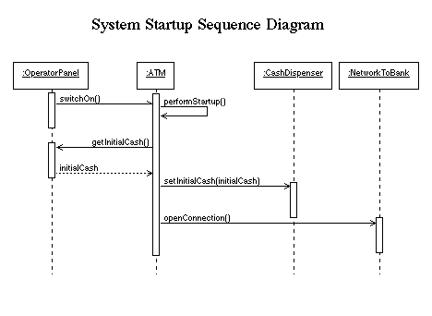
Sequence Diagrams

Slide 33
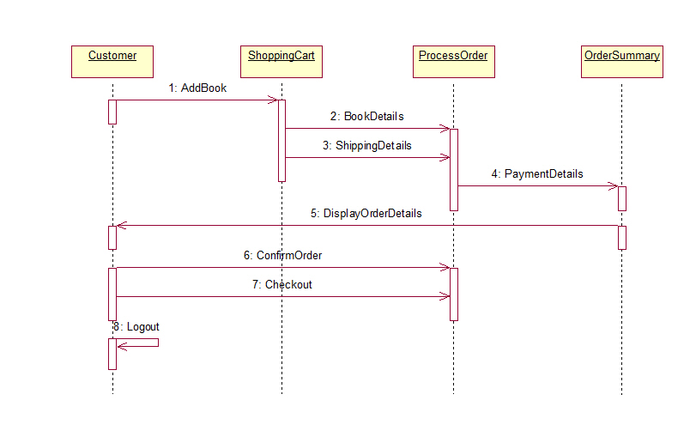


Slide 34
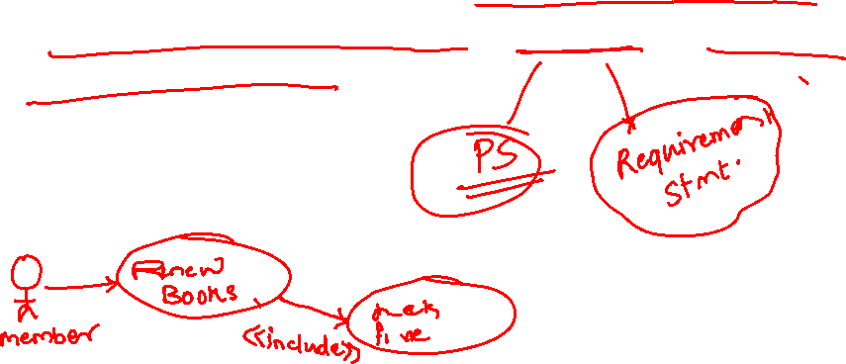
Draw sequence diagram for “Renew books with fine generation for late renewal” scenario in Library Management System
Sequence Diagrams

Slide 35
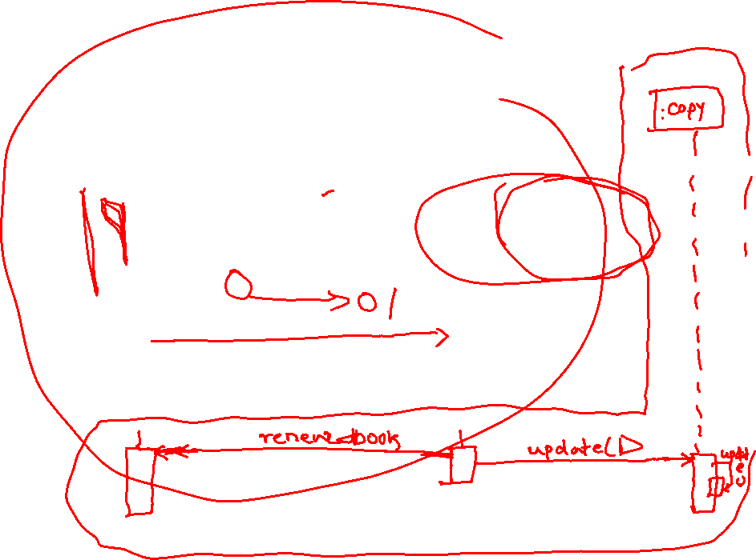
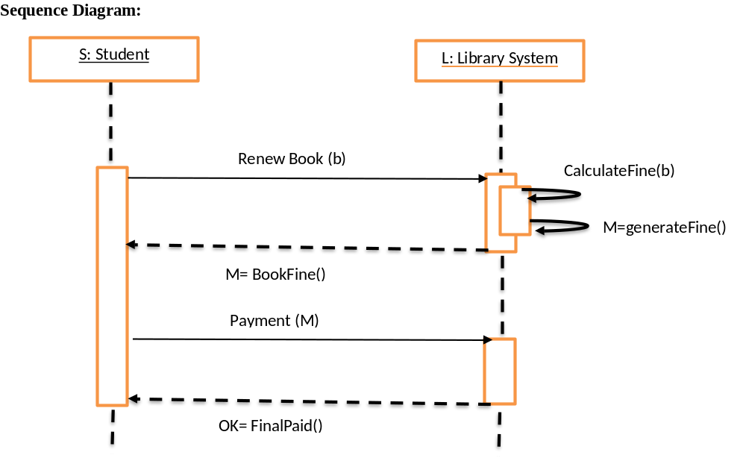

Slide 36

Example
In a hospital, nurse simultaneously requests the medical lab to reserve a date for the patient’s diagnostic test (t) and the insurance company to approve the test. If the Insurance Company approves the test, then the Nurse will schedule the test on the date supplied by the Medical lab.

Slide 37
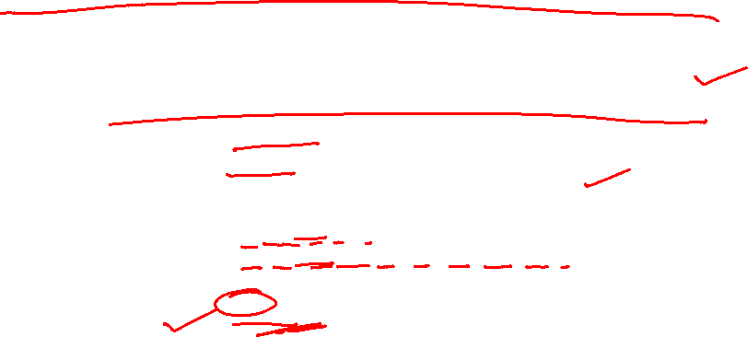
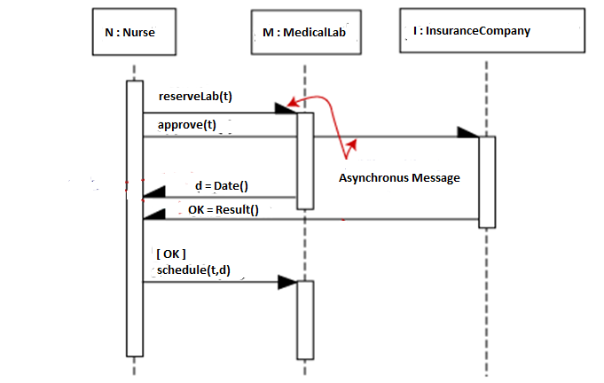
Asynchronous messages
.

Slide 38
Nested activation

Slide 39
Control information
Condition
  syntax: ‘[‘ expression ’]’ message-label
  The message is sent only if the condition is true
  example:
Iteration
  syntax: * [ ‘[‘ expression ‘]’ ] message-label
  The message is sent many times to possibly multiple receiver objects.
[ok] borrow(member)

Slide 40
Control Information (Cont.)
Iteration examples:
:CompoundShape
:Shape
:Driver
:Bus
draw()
*draw()
*[until full] insert()
The syntax of expressions is not a standard

Slide 41
Control Information (Cont.)
The control mechanisms of sequence diagrams suffice only for modeling simple alternatives.
  Consider drawing several diagrams for modeling complex scenarios.
  Don’t use sequence diagrams for detailed modeling of algorithms (this is better done using activity diagrams, pseudo-code or state-charts).

Slide 42
Interaction Fragment in Sequence Diagram
An Interaction fragment which defines an expression of interaction fragments.
An interaction fragment is defined by an interaction operator and corresponding interaction operands. Through the use of interaction fragments the user will be able to describe a number of traces in a compact and concise manner.
interaction fragment may have constraints also called guards in UML

Slide 43
  Typical frame operators are:
Frame Operator | Semantics
alt | Alternative fragment for mutual exclusion conditional logic expressed in the guards.
loop | Loop fragment while guard is true. Can also write loop(n) to indicate looping n times.
opt | Optional fragment that executes if guard is true.
par | Parallel fragments that execute in parallel.
region | Critical region within which only one thread can run.

Slide 44
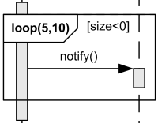
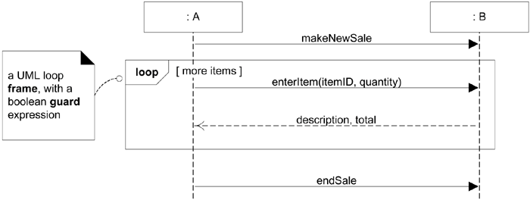
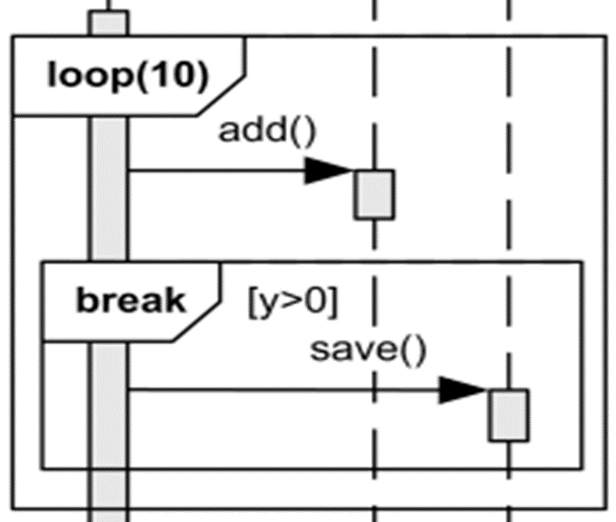
Frames in UML Sequence Diagrams :
  To allow the visualization of complex algorithms, sequence diagrams support the notion of frames;
  Frames are regions of the diagrams that have an operator and a guard,. Figure.

Slide 45
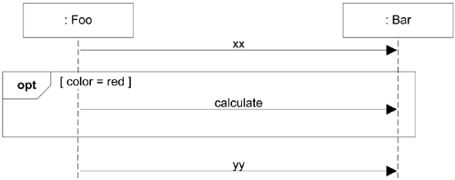
Figure Using the opt Frame
  Next Figure illustrate the use of the alt frame for mutually exclusive alternatives

Slide 46
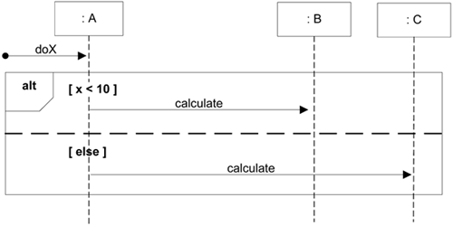
Figure Using the alt Frame

Slide 47
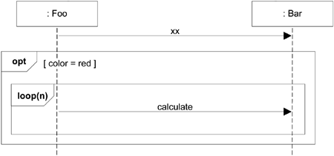
Nesting of Frames :
  Frames can be nested:

Slide 48
MyManipal is an online social networking service only for MIT students and staff. The users must register before using the site. Once the user is authenticated he can retrieve notification, updates and messages. Further, in the next step the user can change the user preferences as online/ hidden. Finally, the status will be displayed in users’ wall. Unsuccessful login will lock the account for 1 minute to prevent from brute force attack.

Slide 49
The user wants to boot a server with Linux operating system (OS). So whenever the user sends a signal start the operating system will load RAM and the booting process will be initiated. After a time interval, the OS will get its current date and time. Moreover, the user will be acknowledged with current date d and time t by the OS within a stipulated time period. Based on the user request the OS will spawn two processes simultaneously namely P_{i} and P_{j}. The order of creation of above two processes is random. Each process will return its pid to OS. Due to the scarcity of resources the OS is required to kill any one of the processes. The built-in functionality in OS called Preemptive Algorithm chooses P_{i} as victim process. OS sends a signal kill to kill the process P_{i.} If the OS is unsuccessful in killing the process P_{i}, then the OS will send kill message to kill the process P_{j}.

